Slide 1
Global Natural Scene Recognition
Nahal Bagheri
CS-171

Slide 2
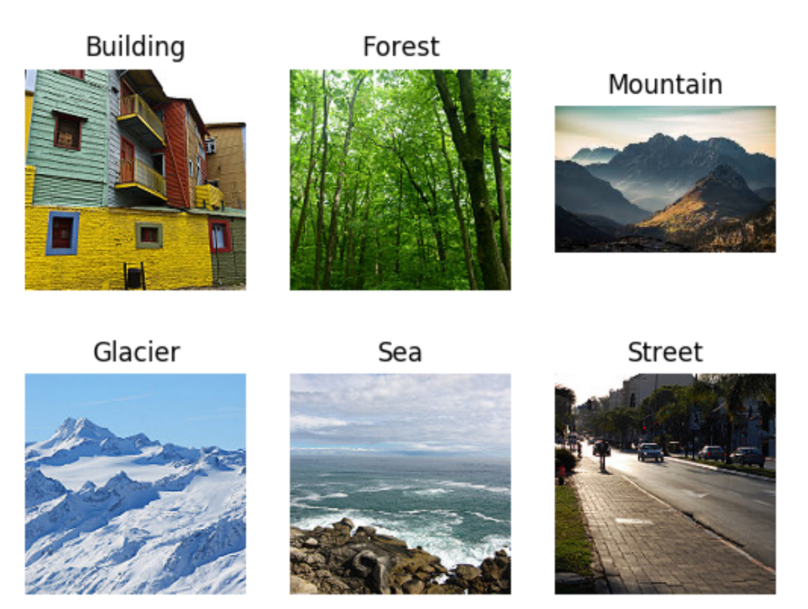
Introduction
The realm of image classification has expanded significantly with the advent of convolutional neural networks (CNNs).
This task holds substantial importance in various applications, such as geographic information systems, environmental monitoring, and even in enhancing user experience in travel and educational applications.

Slide 3
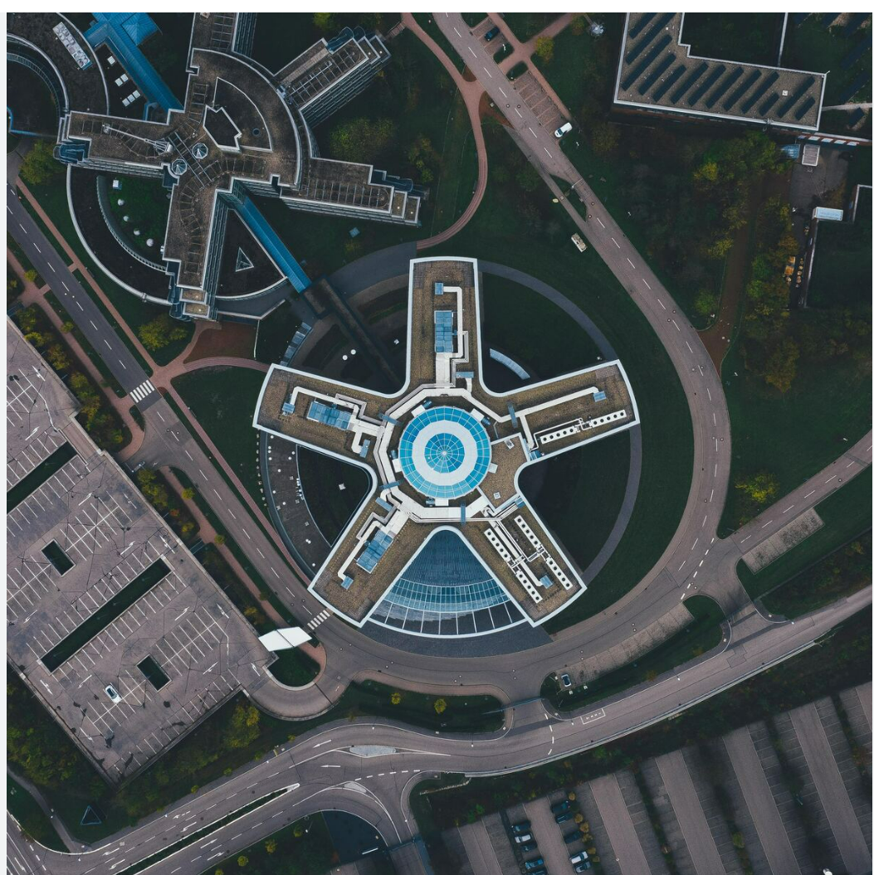
Data Overview
For this project, I have chosen a robust dataset from Kaggle, renowned for its diversity and quality of image data. The dataset contains thousands of labeled images across multiple categories of natural scenes, providing a rich training ground for our CNN model.
This Data contains around 25k images of size 150x150 distributed under 6 categories:
{'buildings' -> 0, 'forest' -> 1, 'glacier' -> 2, 'mountain' -> 3, 'sea' -> 4, 'street' -> 5 }
The dataset chosen for this project is the "Intel Image Classification" dataset, available on Kaggle at the following link: Intel Image Classification Dataset.

Slide 4
Methodology
The methodology for this project will primarily revolve around Convolutional Neural Networks (CNNs), given their proven efficacy in image recognition tasks. CNNs are particularly adept at preserving the spatial hierarchy of features in an image, making them ideal for this application.
Neural Network Architecture and Configuration:
Input Layer
Pooling Layers
Dropout Layers
Output Layer
Specific Algorithms, Libraries, or Frameworks:
TensorFlow
Keras

Slide 5
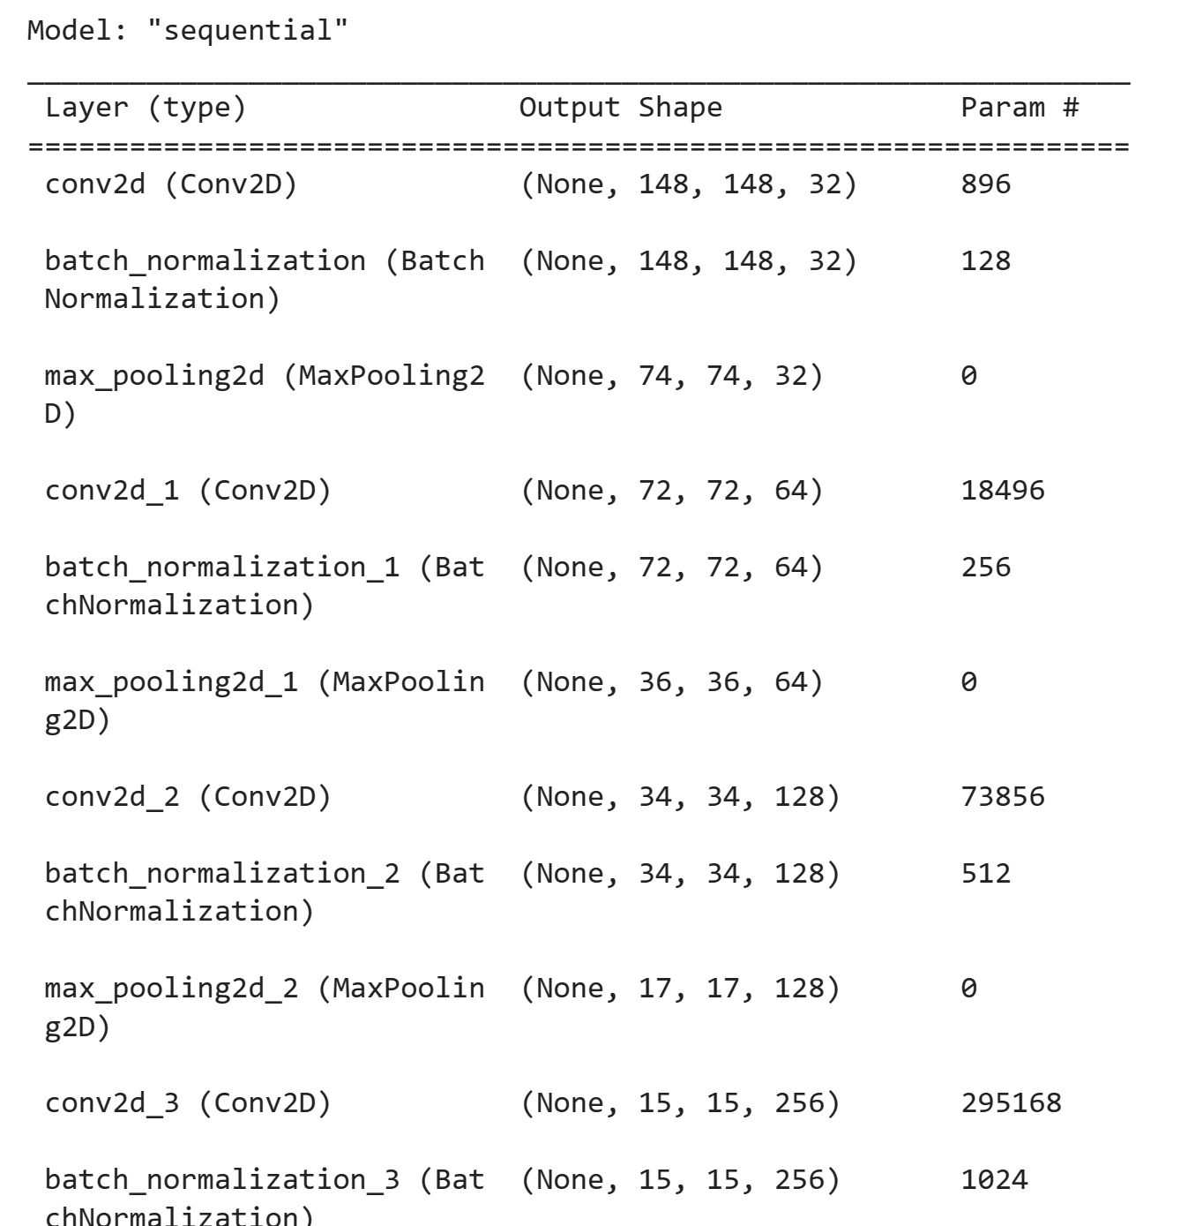
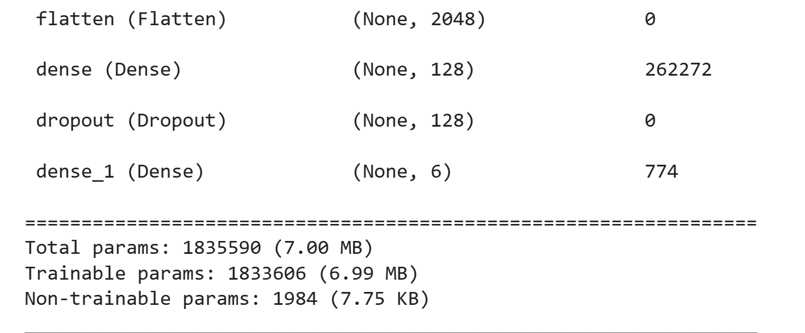
Results
TensorFlow/Keras implementation of a Convolutional Neural Network (CNN) for image classification:

Slide 6

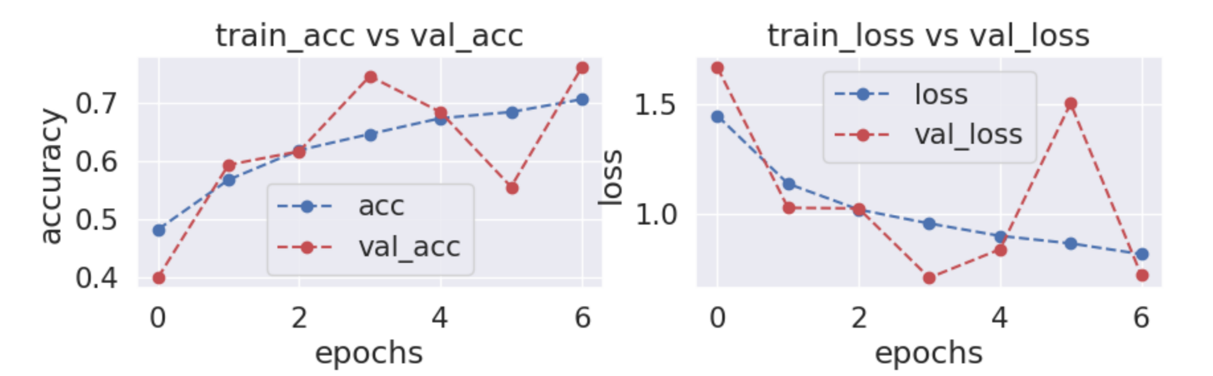
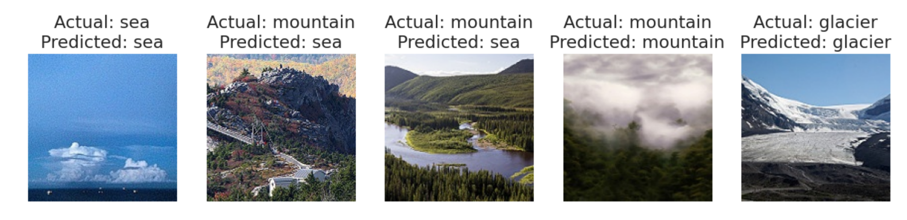
Discussion
Accuracy: This is the most straightforward metric, indicating the overall proportion of correct predictions. It provides a quick understanding of the model's effectiveness across all classes.

Slide 7
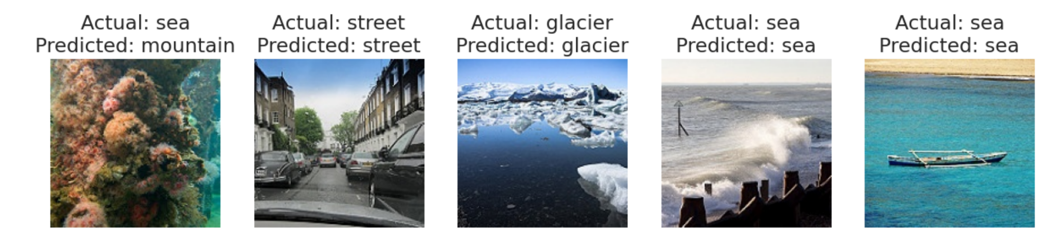
Conclusion
This project proposal outlines a comprehensive plan to leverage Convolutional Neural Networks (CNNs) and ensemble learning methods for the classification of natural scene images. I utilized a well-structured dataset from Kaggle, which includes diverse images of natural landscapes categorized into six classes. The methodology described aims to overcome limitations of current approaches by proposing a more computationally efficient model without sacrificing accuracy.

Slide 8

Q&A
Any Questions!

